Slide 2
BLOCKCHAIN TECHNOLOGY
Computer Engineering
BE Semester VII
Prof. Swapnil Sonawane

Slide 3
Module 1: introduction to blockchain

Slide 4
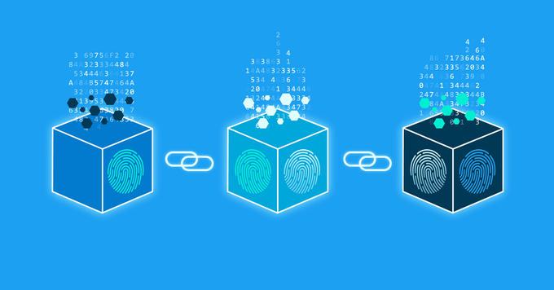
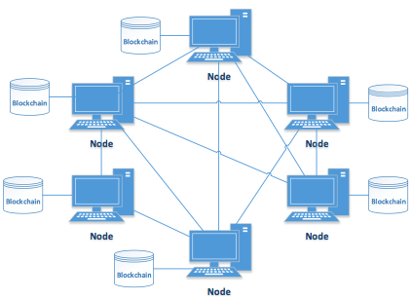
BLOCKCHAIN structure

Slide 5
Definition of BLOCKCHAIN
Blockchain is defined as a distributed, replicated and peer-to-peer network of databases that allows multiple non-trusting parties to transact without a trusted intermediary and maintains an ever-growing, append-only, temper-resistant list of time-sequenced records.

Slide 6
Basic operations on BLOCKCHAIN
Broadcasting transactions
Validation of transactions
Gathering transactions for a block
Consensus on new block creation
Chaining blocks

Slide 7
How BLOCKCHAIN technology works
A transaction is initiated
A transaction is broadcasted to peer-to-peer network
A network of node validate transaction
A verified transaction can involve cryptocurrency, contact, record or any transaction
A transaction is combined with other transactions and keep in a block
A miner uses consensus algorithm to add new block in blockchain
A transaction is now called as finished and hence immutable

Slide 8
components of BLOCKCHAIN
1. Node:
A node is an electronic device (computer or mobile device) that are connected to the internet.
In blockchain, any computer or hardware device that is connected to blockchain network is called as a node.
All the nodes in the network have a copy of blockchain ledger and are interconnected

Slide 9
A node can be:
A. Full Node:
A node maintains a full copy of the transaction history of the blockchain. They also help the network by processing and accepting transactions or blocks, validating those transactions or blocks and then broadcasting them to the network.
B. Partial/ Lightweight/ Light Node:
It maintains only partial copy of a blockchain and normally used when user do not have sufficient disk space for full blockchain. They only download the block headers to see transactions.

Slide 10
2. Ledger:
It is digital database of information that is immutable
Its properties are:
Ledger is public as anyone can access the ledger and can read or verify the transactions
Ledger is distributed because all the nodes in the blockchain have a copy of blockchain ledger
Ledger is decentralized so no node have excessive control over ledger and hence no single point of failure

Slide 11
3. Wallet:
It is a digital wallet that allows user to manage cryptocurrency like bitcoin, ether etc. One can send and receive cryptocurrency using wallet
Its features are:
Privacy is maintained: When wallet is created, user's public and private key also generated. We need to share public key to receive funds
Transactions are secured: Private key is used to send funds as well as open encrypted message
Ease of usage: Wallets can be installed and accessed from web, desktop or mobile device without intermediatory like banks
Currency conversion: We can transact over various types of cryptocurrencies like BTC, ETH, LTC etc.

Slide 12
4. Nonce:
It is an arbitrary number generated randomly that can be used while block is added. It is a key for creating block in blockchain
5. Hash:
A hash function can take data of any size, perform an operation on it and return a “hash” of that data of fixed size. It has following characteristics:
It creates unique hash for data
It is one dimensional, means we can not recreate data from its hash
A very minute change in data gives different hash
It keeps database small

Slide 13
6. Mining:
It is the mechanism, where miners or forgers validate new transactions and add them to the blockchain ledger.
It is done by solving complex cryptographic hash puzzles to verify blocks of transactions that are updated on the decentralized blockchain ledger.
Solving these puzzles requires powerful computing power and sophisticated equipment. In return, miners are rewarded with bitcoins.

Slide 14
7. Consensus protocol:
Consensus for blockchain is a procedure in which the peers of a Blockchain network reach agreement about the present state of the data in the network.
Through this, consensus algorithms establish reliability and trust in the Blockchain network.
Example: Proof-of-work, Proof-of-stake etc.

Slide 15
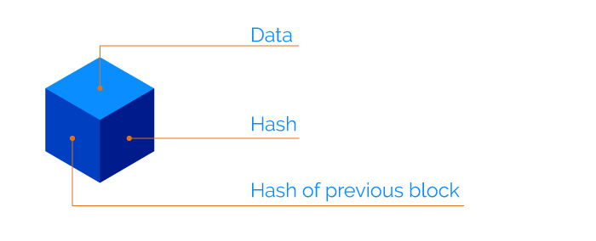
Block in blockchain
Each block containing the data, its own hash value and a pointer to the hash of the previous block

Slide 16
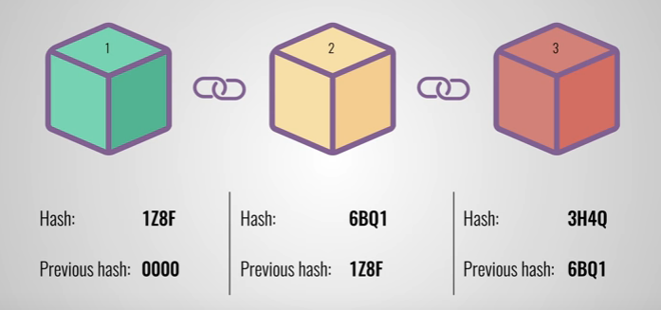

Slide 17
A block is a place in a blockchain where information is stored and encrypted.
Blocks are identified by long numbers that include encrypted transaction information from previous blocks and new transaction information.
Blocks and the information within them must be verified by a network before new blocks can be created.
Blocks and blockchains are not used solely by cryptocurrencies. They also have many other uses.

Slide 18
The header of the block is divided into six components:
The version number of the software
The hash of the previous block
The root hash of the Merkle tree
The time in seconds since 1970–01–01 00:00 UTC
The goal of the current difficulty
The nonce

Slide 19
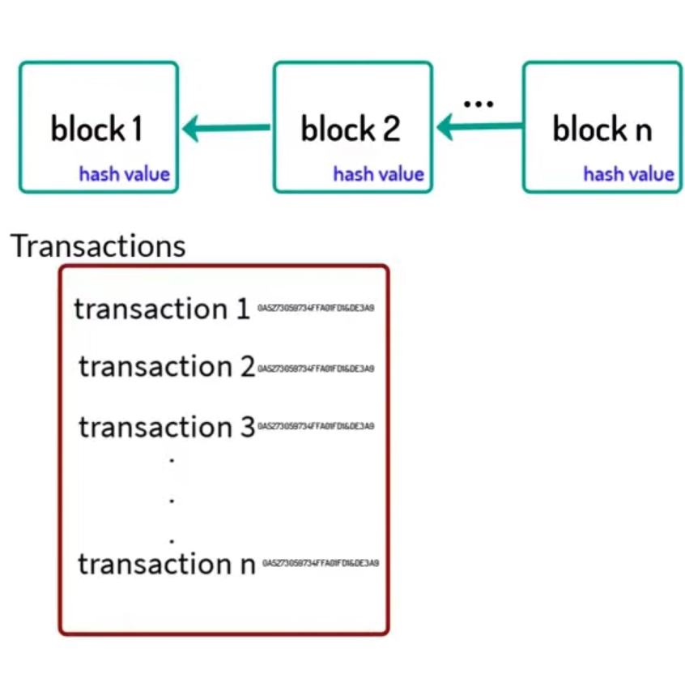
Merkle tree

Slide 20
Merkle trees, also known as Binary hash trees, are a prevalent sort of data structure in computer science.
In bitcoin and other cryptocurrencies, they're used to encrypt blockchain data more efficiently and securely.
It's a mathematical data structure made up of hashes of various data blocks that summarize all the transactions in a block.
It also enables quick and secure content verification across big datasets and verifies the consistency and content of the data.

Slide 21
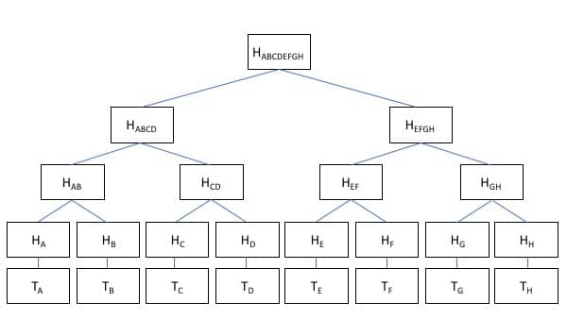

Slide 22
Types of BLOCKCHAIN
Public Blockchain:
It is public permissionless blockchain
In public blockchain, anyone in the world can access the blockchain, download a copy and run the node.
One does not need any permission to read/access a transaction, initiate the transaction or participate in the consensus process to create a block.

Slide 23
Features of public blockchain:
Anyone can join the network and be the participant
No permissions are required for anyone to read/send transactions
The standard consensus algorithm used is Proof-of-Work (PoW) where nodes (miners) solve the hash puzzle and submit their resultant block to the rest of the network participants for consensus
High cryptographic methods are used to secure data
It has low transaction processing speed
Consensus mechanism requires an immense amount of energy and computation power

Slide 24
Private Blockchain:
It is private permissioned blockchain
The network is not open to anyone.
Features of decentralization and openness is lost as all the permissions are controlled by few nodes in organization
Here owner has sole control over who can read, write or validate the data, it stands to reason why many may not consider it to be a real blockchain

Slide 25
Features of private blockchain:
It is not open to public
All participants are pre-approved by the organization
The owner or central authority controls the permission to read, write or audit the ledger
It has high transaction processing speed
A central authority means single point of failure
The organization must agree on who has the highest power to be the central authority.

Slide 26
Consortium Blockchain:
It is also known as Federated blockchain
It is permissioned blockchain and considered to be hybrid between public and private blockchain
It is a distributed ledger that anyone can download, or access and the consensus process is not controlled by one company but by the predetermined consortium of companies or representative individuals.

Slide 27
Features of consortium blockchain:
Any member node can initiate and receive transactions but permission to audit the ledger is done by pre-approved individuals only
They are faster as compared with public blockchain
They are not fully decentralized
Agreement on a standard set of rules may get challenging

Slide 28
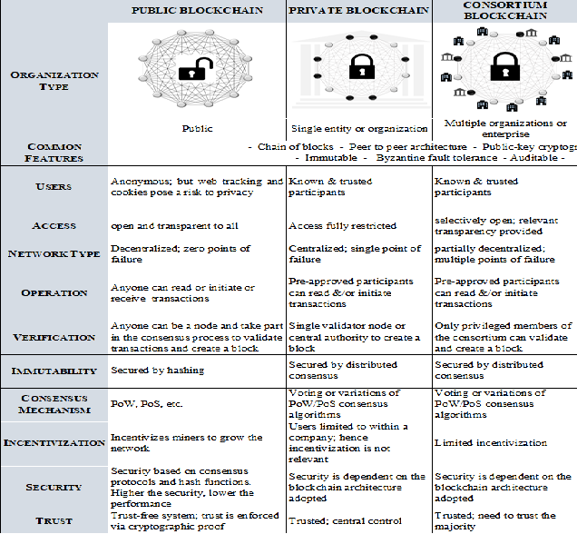

Slide 29
Consensus algorithms
Proof of Work:
Proof of Work(PoW) is the original consensus algorithm in a blockchain network.
The algorithm is used to confirm the transaction and creates a new block to the chain. In this algorithm, minors (a group of people) compete against each other to complete the transaction on the network.
The process of competing against each other is called mining. As soon as miners successfully created a valid block, he gets rewarded.
The most famous application of Proof of Work(PoW) is Bitcoin.

Slide 30
Proof of Elapsed Time:
Proof of elapsed time (PoET) is a consensus algorithm developed by Intel Corporation that enables permissioned blockchain networks to determine who creates the next block.
PoET follows a lottery system that spreads the chances of winning equally across network participants, giving every node the same chance.
The PoET algorithm generates a random wait time for each node in the blockchain network; each node must sleep for that duration.
The node with the shortest wait time will wake up first and win the block, thus being allowed to commit a new block to the blockchain.
The PoET workflow is similar to Bitcoin's proof of work (PoW) but consumes less power because it allows a node to sleep and switch to other tasks for the specified time, thereby increasing network energy efficiency.

Slide 31
Proof of Stake:
With proof-of-stake (POS), cryptocurrency owners validate block transactions based on the number of coins a validator stakes.
Proof-of-stake (POS) was created as an alternative to Proof-of-work (POW), the original consensus mechanism used to validate a blockchain and add new blocks.
An algorithm chooses from the pool of candidates the node which will validate the new block.
This selection algorithm of Validators or Forgers combines the quantity of stake (amount of cryptocurrency) with other factors (like coin-age based selection, randomization process) to make the selection fair to everyone on the network.

Slide 32
Delegated Proof of Stake:
Delegated Proof of Stake (DPoS) is a variation of the POS consensus mechanism.
Here, the network participants or nodes use their cryptocurrency or tokens to vote for the delegates.
Just as in POS, the delegates are responsible for validating transactions and maintaining the blockchain ledger. These elected delegates are called witnesses. The more the crypto-coins or tokens, the more the voting power.
Any fraudulent activity by the witnesses can be easily detected by the voters and penalized. As it is a democratic system, it is not only the rich, but all users have a chance to be elected as witnesses and earn rewards. This makes DPOS more decentralized than either PoS or PoW

Slide 33
Proof of Authority:
In PoA, rights to generate new blocks are awarded to nodes that have proven their authority to do so.
These nodes are referred to as “Validators” and they run software allowing them to put transactions in blocks.
These validators are pre-approved and trusted by the network, ensuring that the process is fast and efficient. Unlike other algorithms, PoA relies on the reputation and identity of validators rather than computational power or stake, making it suitable for private or consortium blockchains.

Slide 34
Pros and cons of blockchain
Decentralized and Distributed:
Blockchain technology works on the principle of ledger data distributed to all nodes that are non-hierarchical with no single central control.
Pros:
Removes any single point of failure
Fosters transparency, faster consensus and synching of data
More engagement as everyone is involved in the decision-making process
Cons:
In some cases, the traditional database may be more suited and do the work a lot faster and cheaper
If a time-tested and fully functional database and the operational network are already in place, the benefits of replacing or introducing blockchain may not produce the required return on investment.
Stronger players can take control of the network, impacting decentralization

Slide 35
Trust-lessness:
In the blockchain, cryptography completely replaces the need for third parties to ensure trust.
Pros:
Allows for multiple entities or key players who do not trust each other to transact directly with one another.
Ensures valid and accurate data
Disintermediation (removal of the middleman) reduces the overall cost of transacting.
Cons:
Every node needs to run the blockchain to verify transactions and maintain consensus.
Significant computing power is expended by miners leading to substantial energy consumption and wastage.
Nodes may prioritize transactions with higher rewards.

Slide 36
Immutability:
In blockchain technology, one cannot modify data or transactions once they are recorded in the blockchain database.
Pros:
Contains a verifiable record of all transactions made that is auditable
Consensus algorithms mitigate the risk of double-spending, fraud, and manipulation of data.
There is provenance, i.e., ability to track transaction or product movement across accounts.
Cons:
Not every node has the capacity to maintain and run a full copy of the blockchain.
In smaller blockchains, there is a risk of a 51% attack.

